Slide 1

Churn Modeling for Telecom Client
Akshay Kher
March 4, 2016

Slide 2


Background / Objective
Background
Telecomm marketing is all about keeping subscribers online (on the database) as long as possible. Marketing does everything possible to stop or slow down churn / attrition.
Objective
The primary objective of this study is to find ‘How can we reduce churn?’
Data
Customer level data for ~ 10,000 customers. The dataset includes customer usage, services offered, plan rates etc.

Slide 3
Average duration for customer churn is about 110 days
Half of the customers have a tenure of up-to 100 days
 | Frequency | Avg. tenure (days)
Churned | 55% | 109
Not Churned | 45% | 172

Slide 4
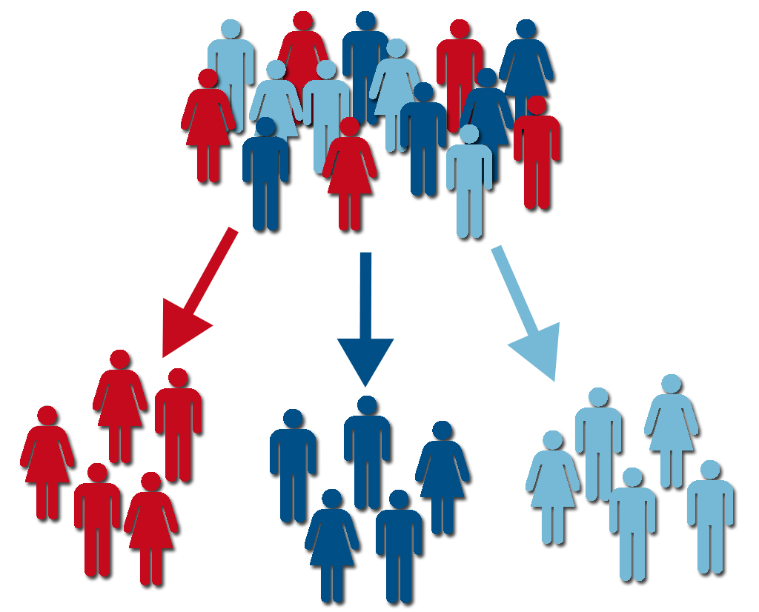
Which customer segments drive revenue for the client?

Slide 5
Segmentation
Based on consumer behavior variables; transaction variables, service usage variables
Variables tested for non-normality by checking z scores > +/- 3.0 standard deviations
Segmentation done using Latent Gold
Following variables were significant for segmentation:
Average Call/IVR Duration
Coupon Adjustments
Distinct Feature Count
Total Dropped Calls
Tenure
Total Minutes
Various cluster solutions tried. Optimum number of clusters found: 3

Slide 6

Segment 1: The Loquacious Lot
68% of the customer base
Average Tenure: 121 days
Longest Average Call & IVR Duration
Maximum Distinct Phone Features
Subscribe to the Expensive Plans
Highest Household Income

Slide 7

Segment 2: The Average Customer
28% of the customer base
Average Tenure: 176 days
Highest Cash and Credit Card Payments
Most Dropped Calls
Switched from Lower to Higher Plans
Moderate Household Income

Slide 8

Segment 3: The Price Sensitive Customer
3% of the customer base
Average Tenure: 145 days
Longest Average Call & IVR Duration
Maximum Coupon Adjustments
Subscribe to the Cheapest Plans
Low Household Income

Slide 9
Survival Modeling
Dependent Variable: Tenure
Censoring Variable: Churned
Distributions Tried: Gamma, Llogistic, Lnormal, Weibull and Exponential
Optimal Distribution found based on: Lowest -2 Log Likelihood
Models run by: Segment
Found 1,000 customers likely to churn in the next 60 days based on predicted TTE
 | Number of Customers in 60 days list | Average TTE
Segment 1 | 719 | 58
Segment 2 | 236 | 60
Segment 3 | 45 | 47

Slide 10
Segment 1: How to reduce churn?
Number of days
Promotional offers/messages through IVR
Provide Auto Bill Pay option. Can offer other services as part of Auto Bill Payment facility
Improve Customer Service
More receptive to Network Complaints

Slide 11
Segment 2: How to reduce churn?
Number of days
Provide E bill option. Promotional offers/messages along with E bill
Prefer Voice service to Broadband. Provide customized plans based on Voice usage.
Bill Payment problem, Disconnect Port Out and Duplicate Activation are pain areas

Slide 12
Segment 3: How to reduce churn?
Number of days
Prefer Bundle services. Unearth preferred combinations of services and offer as a bundle
Hotline service
Discourage more phone features
Risk losing to competition

Slide 13
Financial Implications
Financial Implications have been calculated on the basis of revenue earned as a result of reducing churn
Application of aforementioned strategies by segment can reduce customer churn significantly
Present revenue has been calculated using present TTE, Average plan amount ( in $) and the No. of active phone lines
The additional Number of Days that a customer from each segment can be induced to stay by using the above strategies has been calculated
Based on the new TTE, New Revenue figures have been calculated
Present and New Revenue figures have been compared to calculate Revenue Gain

Slide 14
Revenue Gain by reducing churn
 | 60 day churners | Current TTE | Current Plan $ Amount | Average Active Lines | Revenue | Increased TTE | New TTE | New Revenue | Revenue Gain
Segment 1 | 719 | 57.8 | $ 48.2 | 1.1 | $ 79,569 | 35.0 | 92.8 | $ 127,754 | $ 48,185
Segment 2 | 236 | 61.6 | $ 44.8 | 1.3 | $ 28,719 | 67.6 | 129.3 | $ 60,272 | $ 31,553
Segment 3 | 45 | 47.2 | $ 47.2 | 1.2 | $ 4,114 | 64.4 | 111.6 | $ 9,726 | $ 5,612
Above modeling plan can be tested using segment sensitivities as strategy
10% sample size of each segment can be used to test the modeling strategies
Increased TTE can then be compared to that of the remaining segment to estimate model effectiveness and revenue gain

